Slide 1
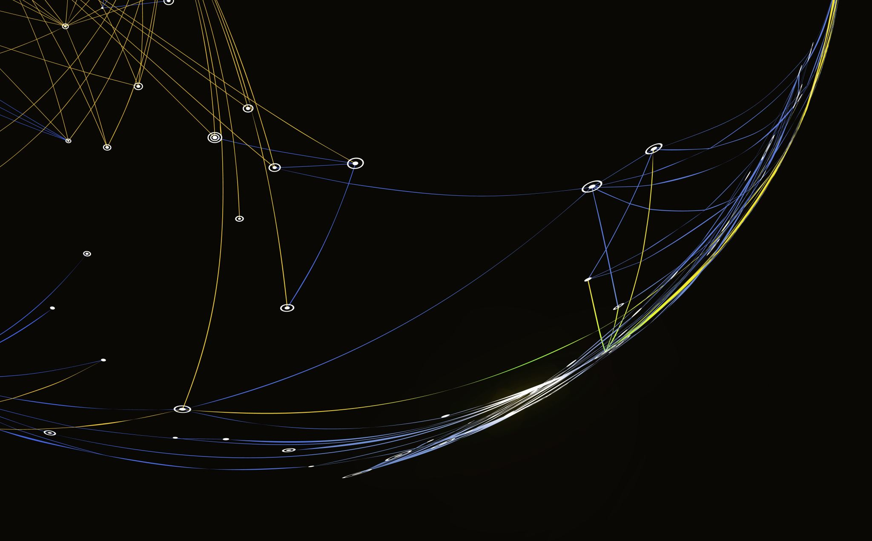
My Projekt – Game chooser
Präsentation by Afonso

Slide 2
Content
My Projekt
How does it work
What tools did I use
What went well
What went wrong
What would I change

Slide 3
MY projekt

Slide 4

How does it work

Slide 5
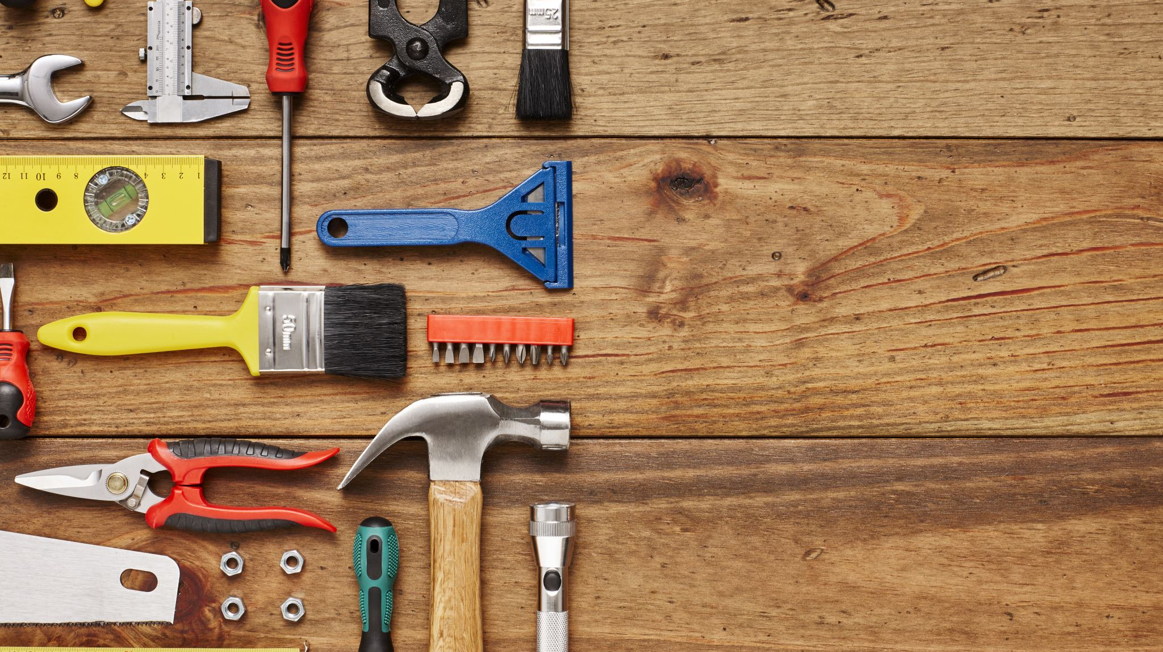
What Tools did i Use

Slide 6
What went well

Slide 7
What went wrong

Slide 8

What would I change
Better coordination and better planning
More Research
Not giving up so fast

Slide 9
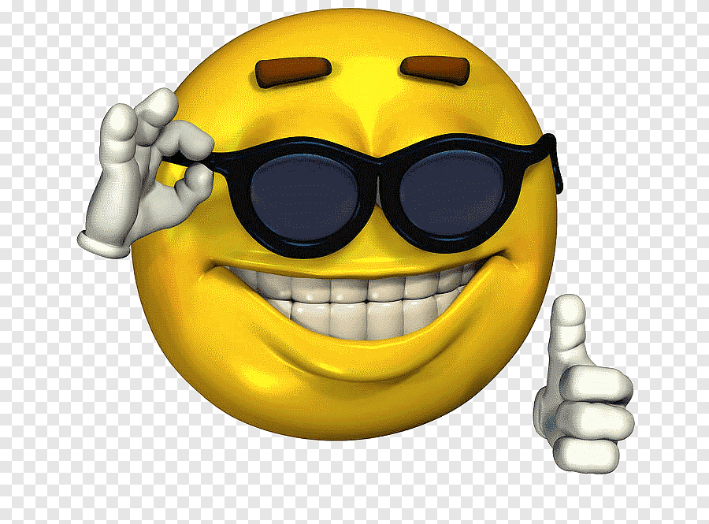

Thanks for listening Questions?

